Slide 1
Tweedie-Based Predictive Modeling Application in Home Insurance
Zhiyu Quan

Slide 2
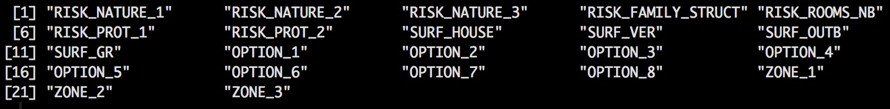
Explanatory Variables

Slide 3
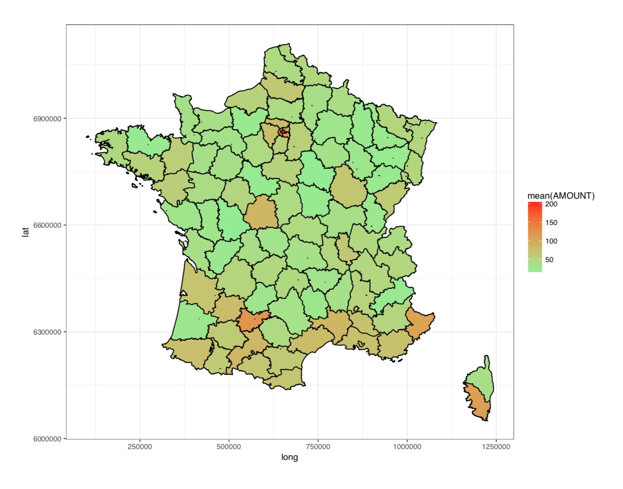
Location is important variable

Slide 4
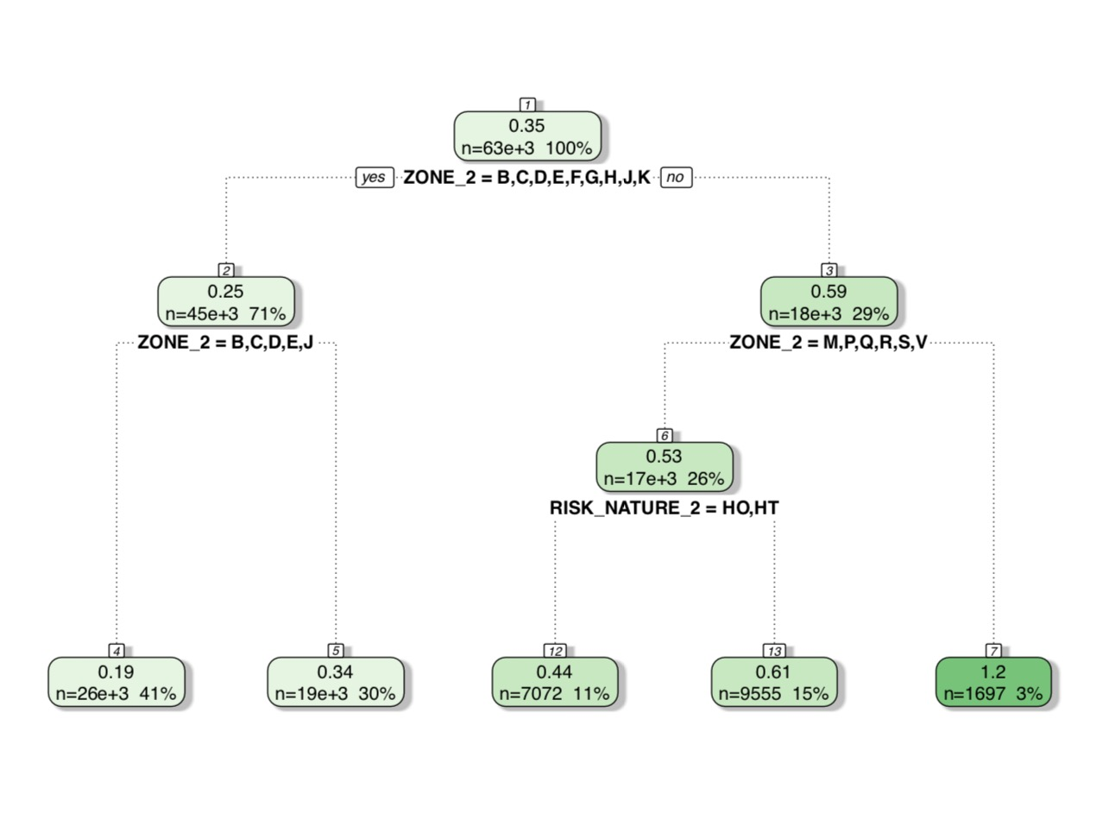
Single Regression Tree

Slide 5
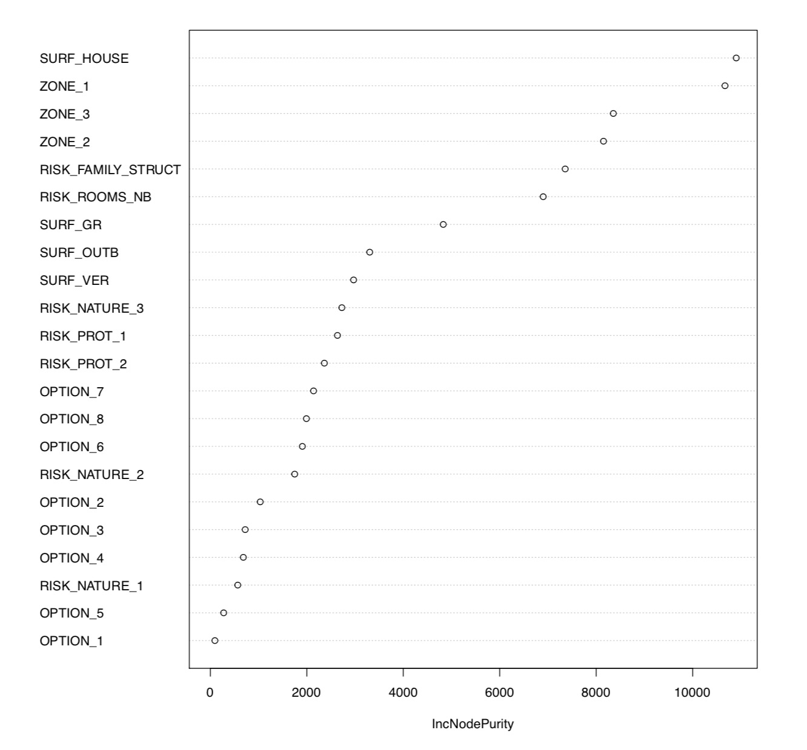
Random Forest - Variable Importance

Slide 6
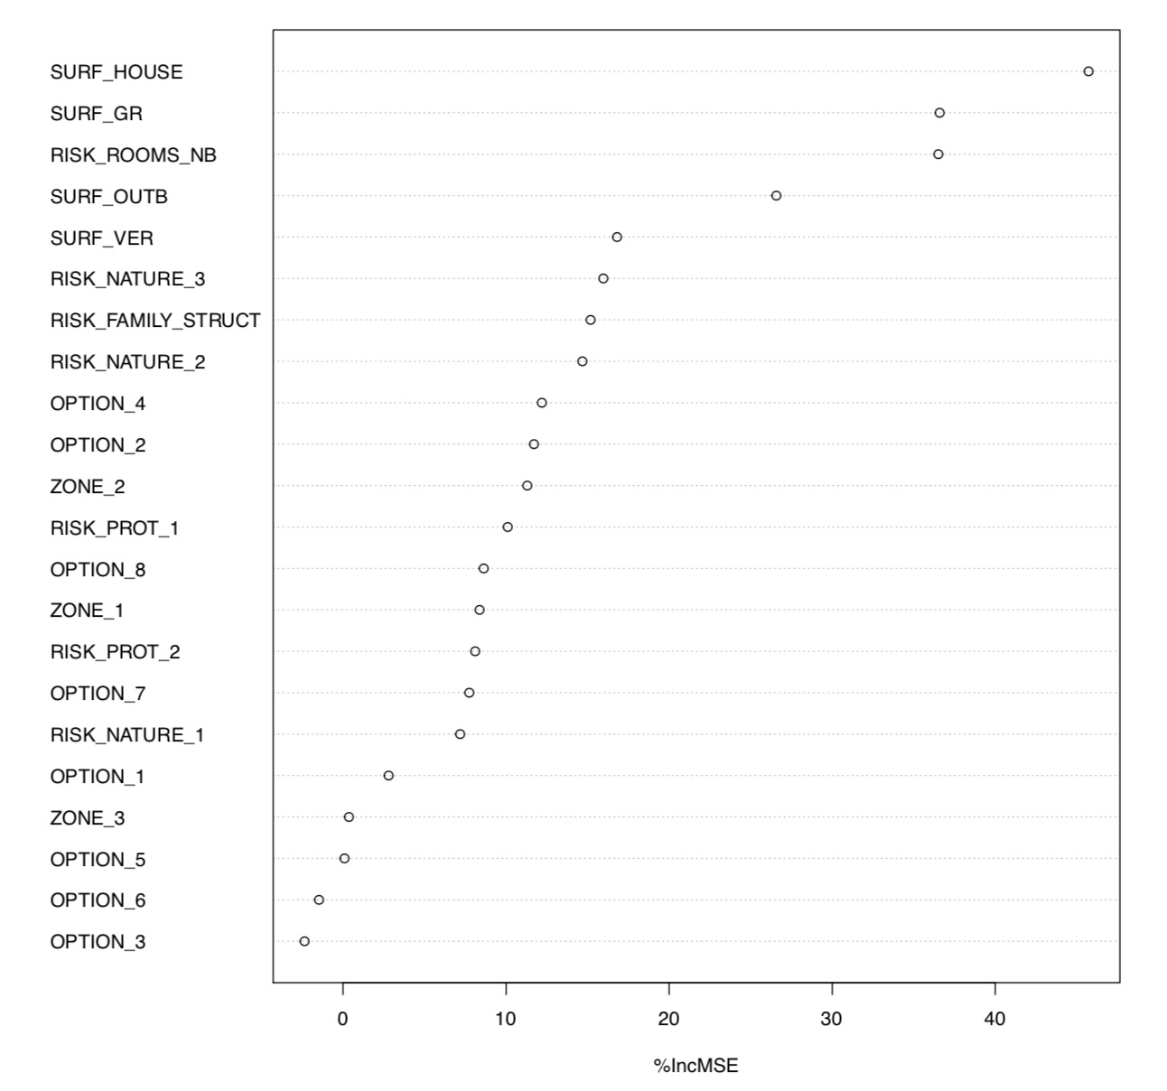
Random Forest - Variable Importance

Slide 7
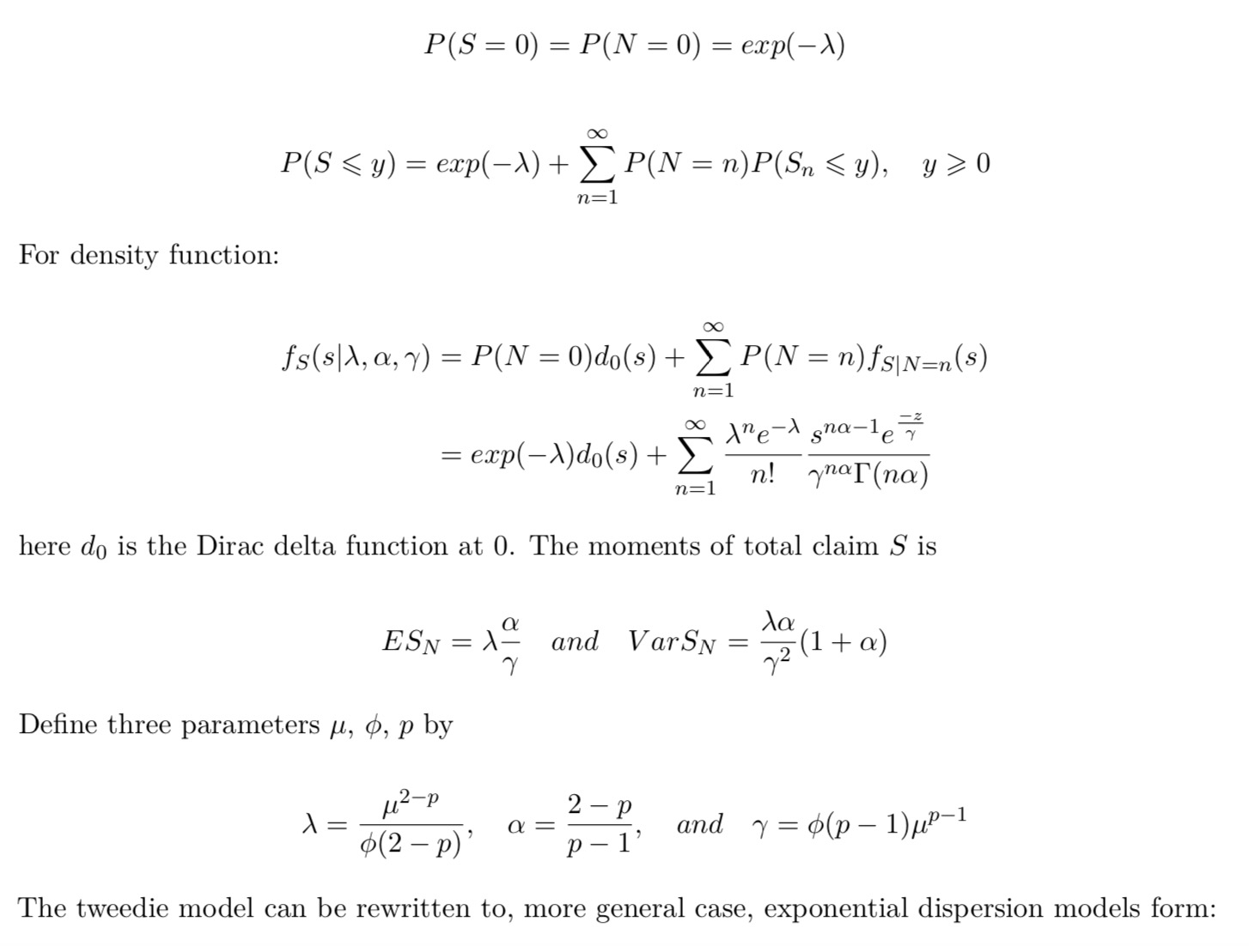
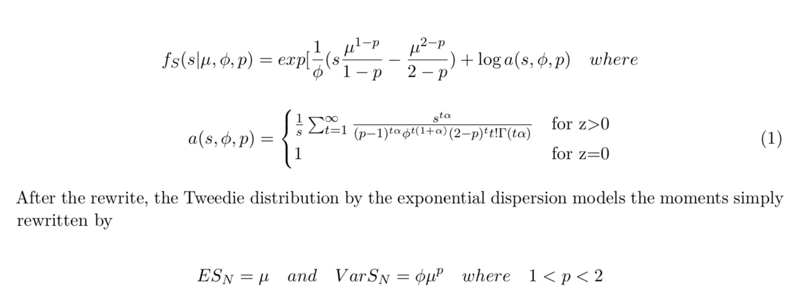
Tweedie-Compound Poisson Distribution

Slide 8
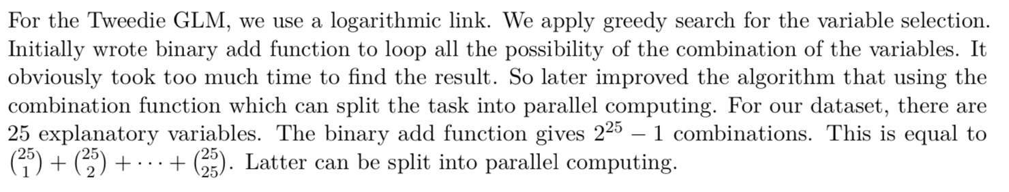
Tweedie GLM with Greedy Search

Slide 9
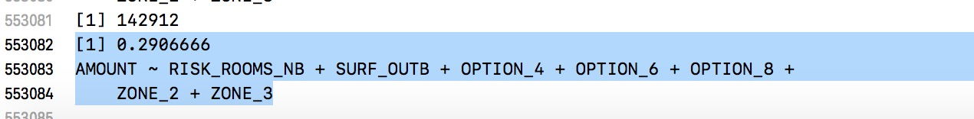
Greedy Search Intermediate Result

Slide 10
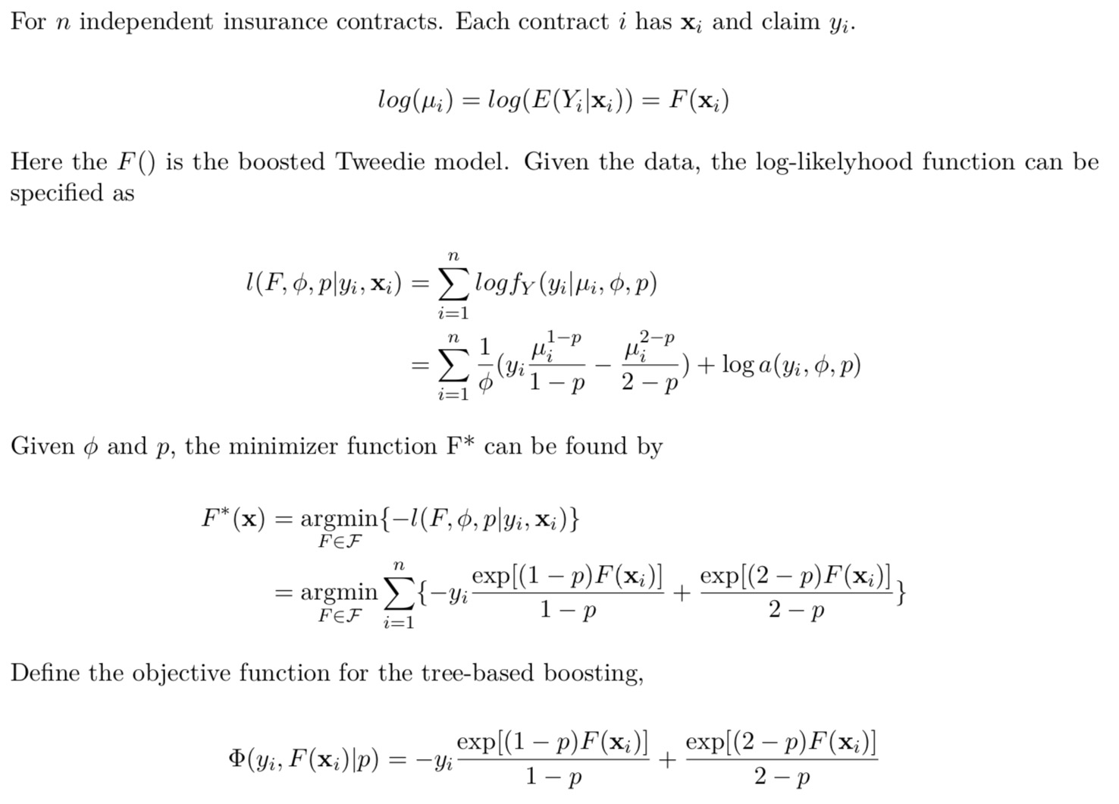
Gradient Tree-Boosted Tweedie

Slide 11
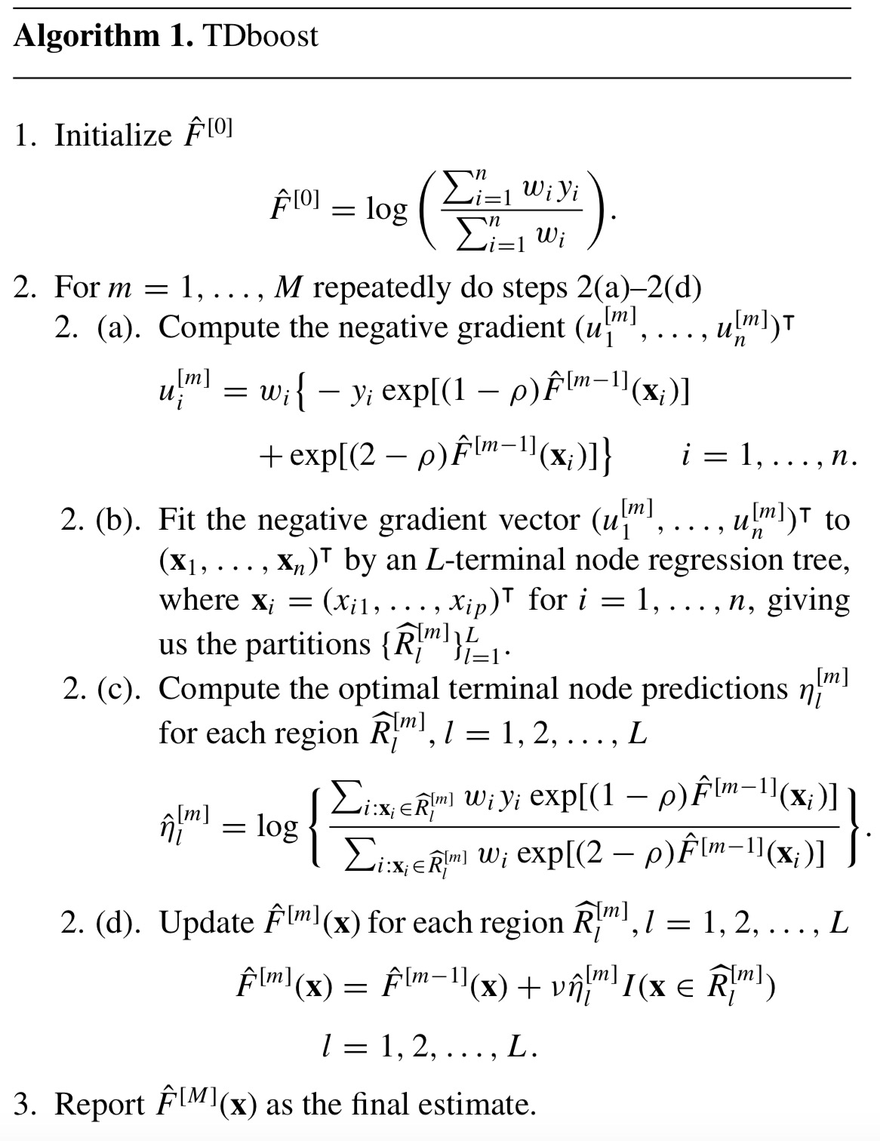

Slide 12
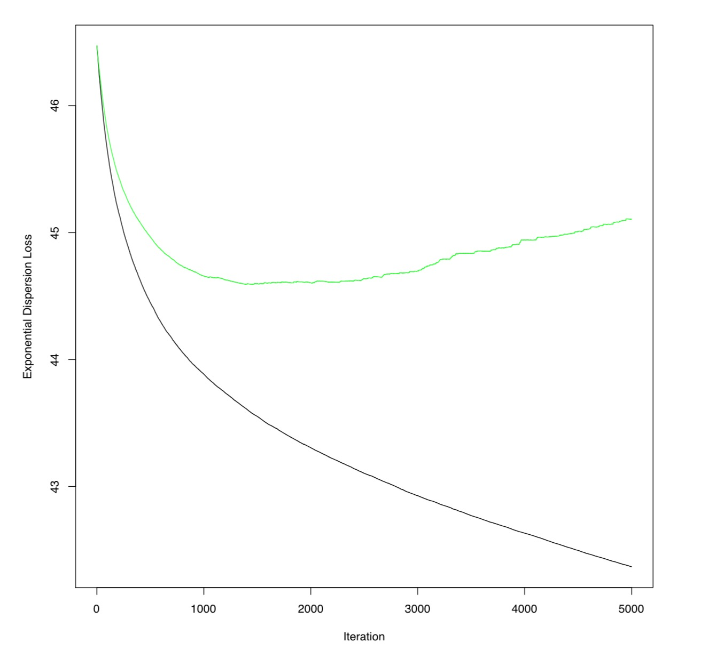
TDboost can be tuned like GBM

Slide 13
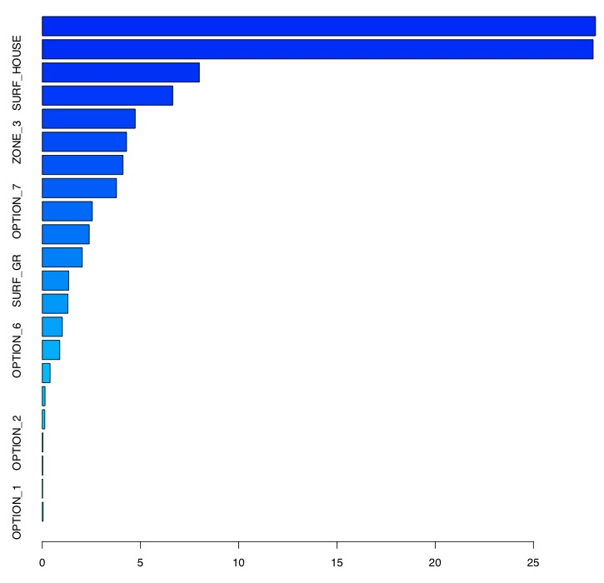
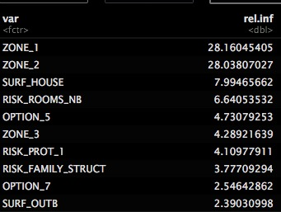
Variable Importance

Slide 14
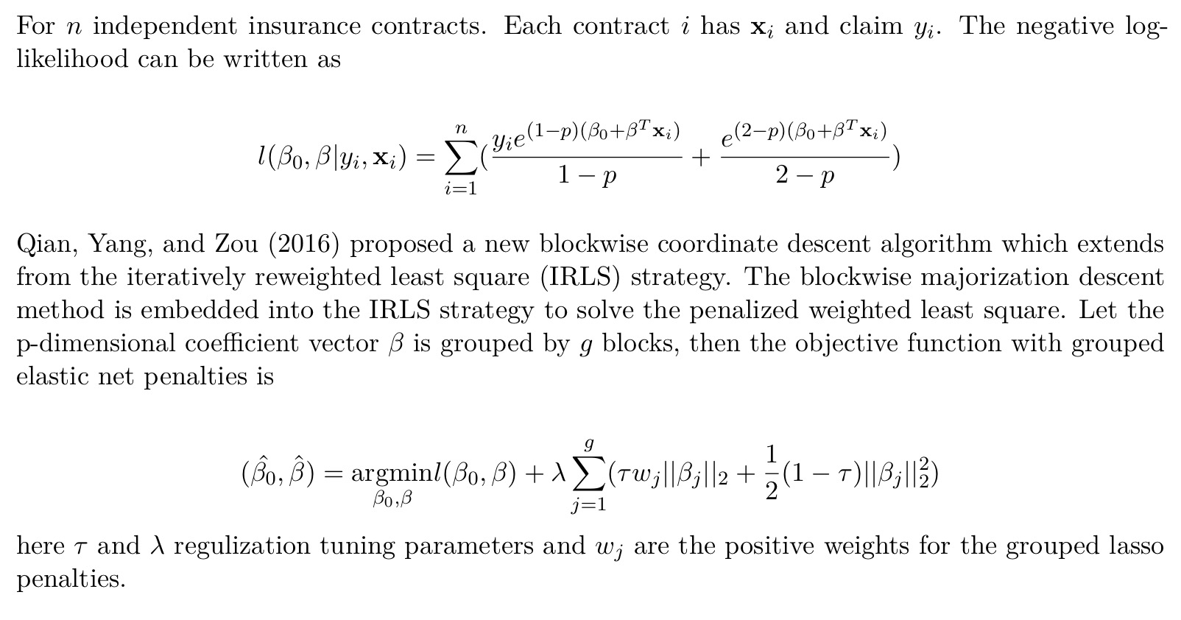
Tweedie Grouped Elastic Net

Slide 15
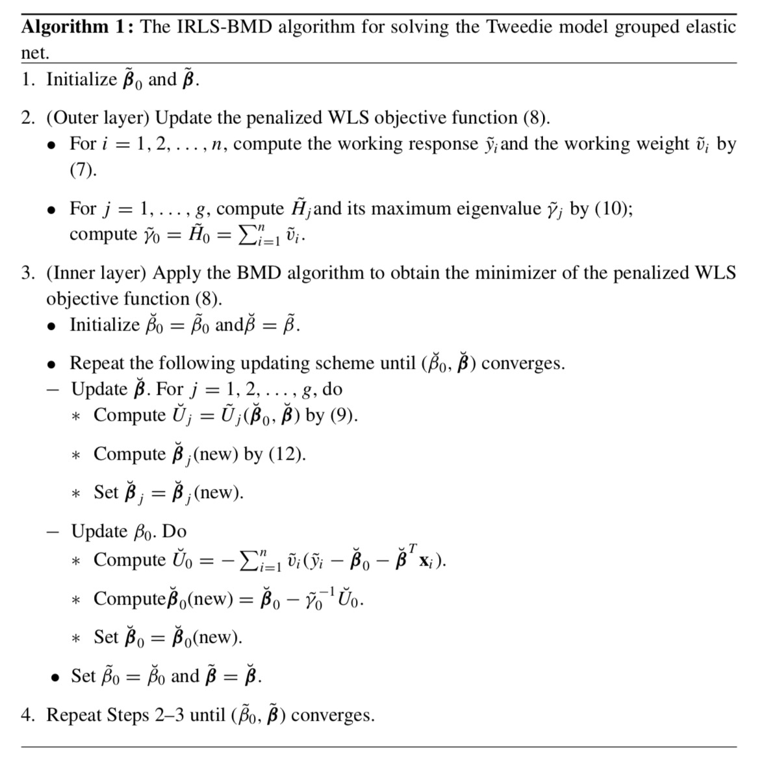

Slide 16
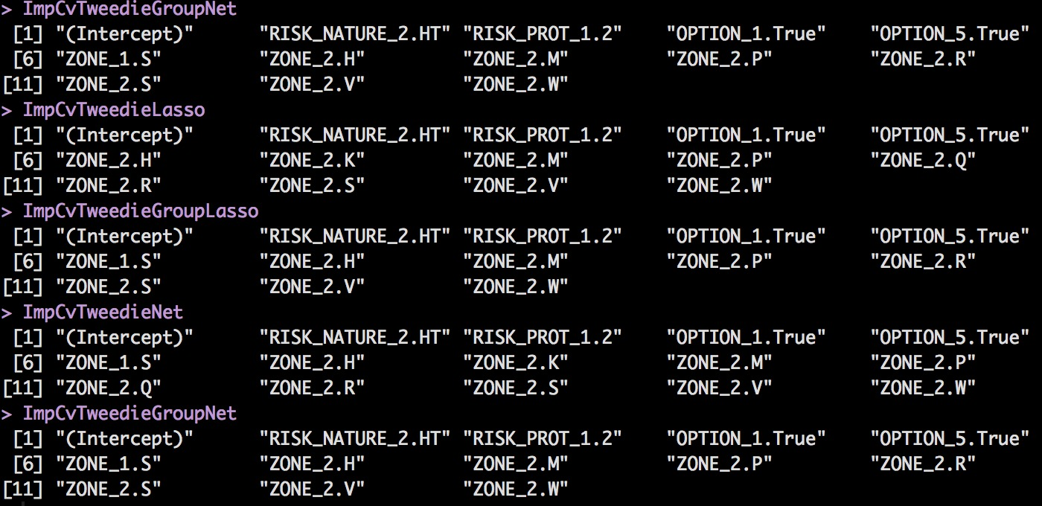
Coefficients size bigger than 0.4

Slide 17
Prediction Accuracy
Model | Gini Index
Greedy Tweedie GLM (intermediate) | 0.2906666
CvTweedieLasso | 0.293131
CvTweedieGroupLasso | 0.2940705
CvTweedieNet | 0.2889836
CvTweedieGroupNet | 0.2967058
CvTDboost | 0.2924537
RandomForest | 0.2188753

Slide 18
Future Work
Wait for the HPC result and try to use GAM models for some variables
Write up the report

